Slide 1



TRIDENT
No accent becomes an accident
Notes:
Hello, SMG Labs would like to present TRIDENT, our innovative solution build on top of caribbean-accent trained ASR

Slide 2
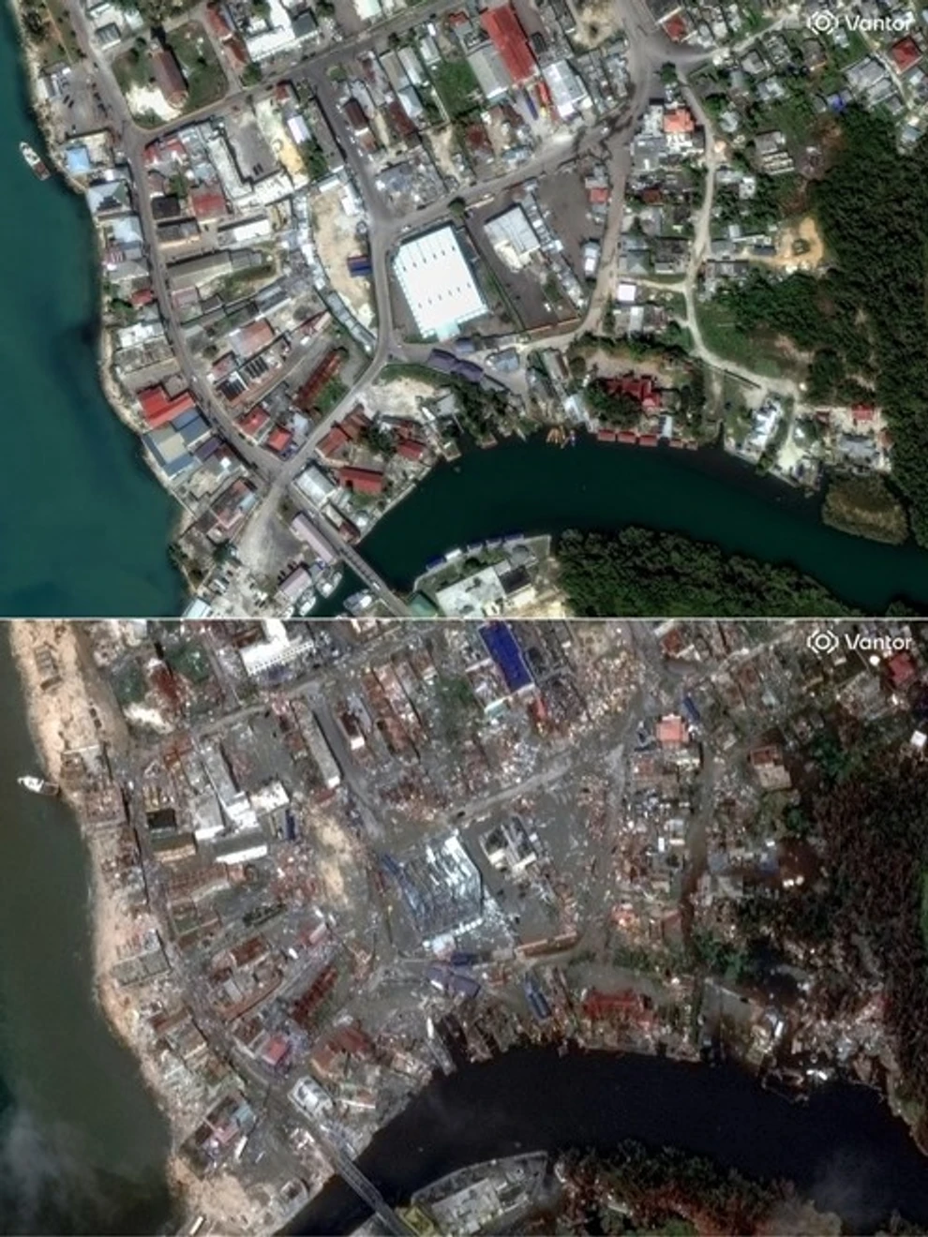
Hurricane Melissa
2025
BEFORE
AFTER
Notes:
Just 2 months ago, Hurricane Melissa made landfall in Jamaica. The strongest storm to hit the island since records began in 1851. In Black River, St. Elizabeth—ground zero—a resident said: "Everyone is homeless right now."

Slide 3
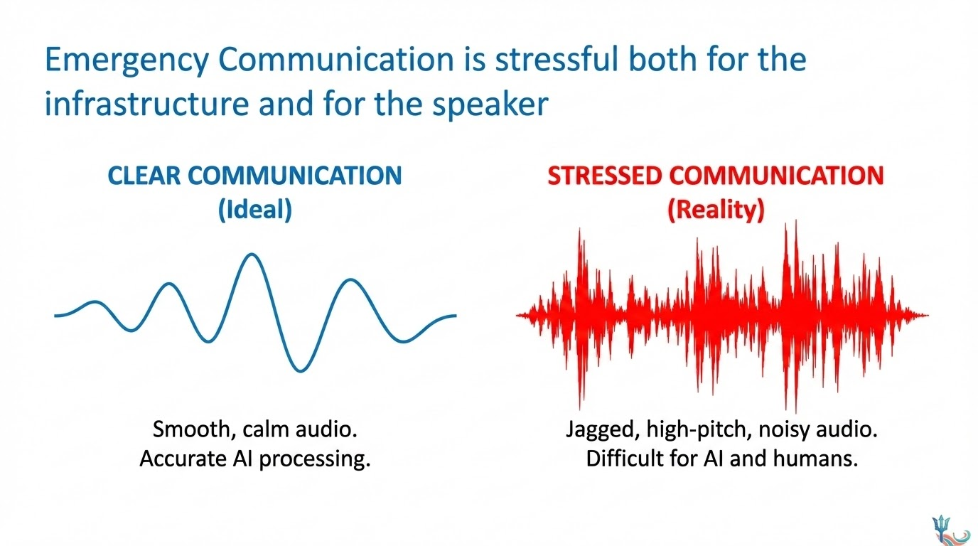
Notes:
But here's what the headlines didn't capture: the communication breakdown.
Less than half the island had working communications after the storm. Emergency dispatchers were overwhelmed.
And there's another failure point that no one talks about: Under extreme stress, people stop code-switching. A professional who speaks Standard English at work will revert to deep, rapid Patois when their house is flooding.
Even if those overwhelmed dispatchers had AI to help, standard speech recognition hears that as background noise. The most vulnerable calls become invisible to the system. An accent becomes an accident.

Slide 4
TRIDENT
Transcription and Routing Intelligence for Dispatcher-Empowered National Triage
Notes:
To address this we built TRIDENT, an emergency routing system that considers the natural language and tone. It works in 3 layers

Slide 5
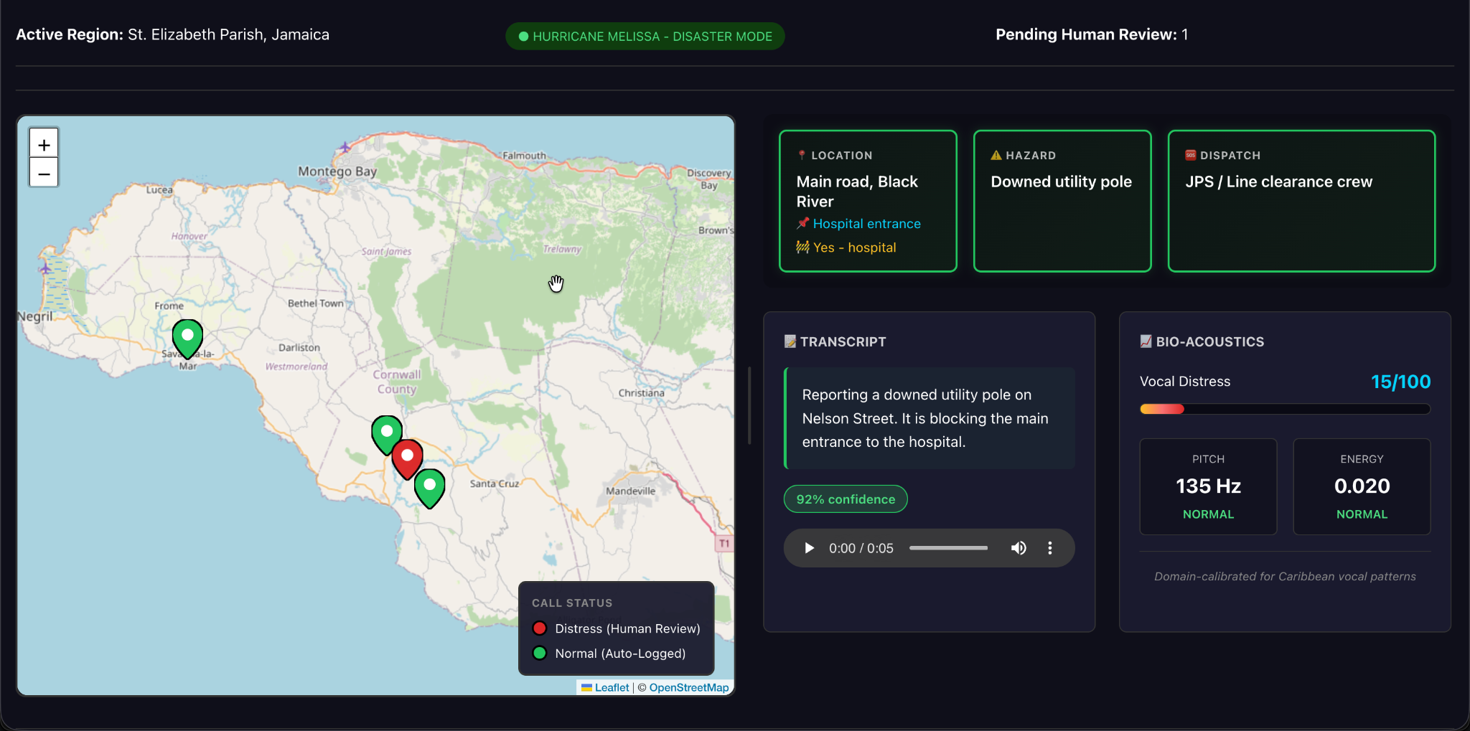


1. Tuned ASR
Speech recognition specifically fine-tuned on Caribbean broadcast data to handle regional accents better than standard models.
Notes:
Layer one: We fine-tuned Whisper on Caribbean broadcast data, because without accurate transcription, everything else fails.

Slide 6

2. Local NLP
An offline Language Model (Llama 3) that extracts key entities: Location, Hazard, and People involved.
Notes:
Layer two: **Local NLP**. We pipe that transcript into a locally-hosted LLMand use it to extract structured, actionable logistics

Slide 7

3. Bio-Acoustics
A safety layer that ignores words entirely, analyzing Pitch and Volume to detect sheer human panic.
Notes:
But what happens when the ASR *can't* understand the words? That's layer three: **Bio-Acoustic Triage**. Recent science has confirmed that when people are in life-threatening danger, their speech patterns tend to change in predictable ways. This layer looks for those bio-markers that AI can hear even if it doesn't speak the language.

Slide 8
The Core Insight
"Low AI confidence is not a bug. It is a signal."
If the AI is confused, AND the caller sounds panicked, that’s a high-priority emergency.
Notes:
The core insight that inspired this design is that low AI confidence doesn’t have to be a bug, it could actually be a feature, enabling dispatchers to apply MOH approved ESI or START protocols to those who need them most.

Slide 9
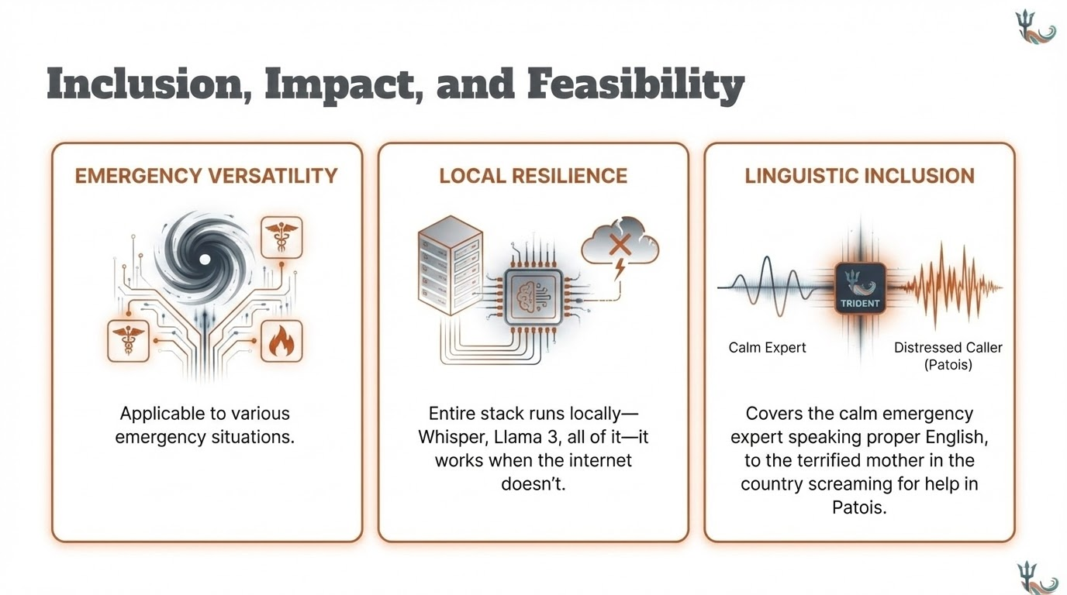
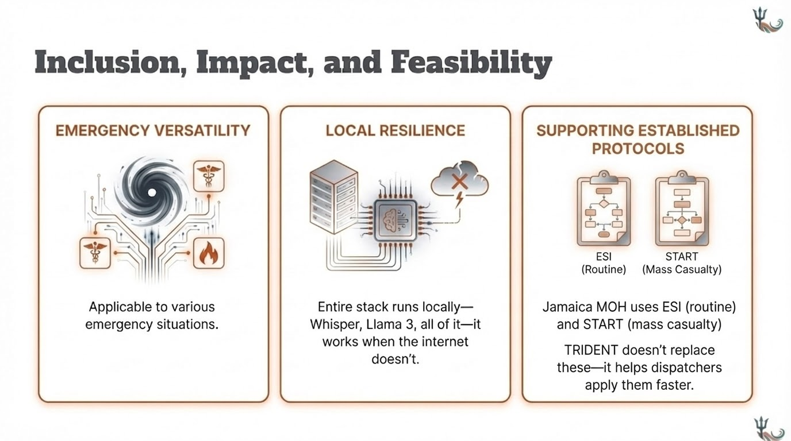
Inclusion, Impact, and Feasibility
EMERGENCY VERSATILITY
Supporting Established Protocols
LOCAL RESILIENCE
Linguistic Inclusion
Notes:
We built this for hurricane response. But the architecture works for *any* emergency call center in the Caribbean. TRIDENT doesn't replace established triage protocols, like Jamaica’s MOH uses ESI (routine) and START (mass casualty), it helps dispatchers apply them faster
Our system can run on a laptop in local shelters or a mobile command unit. No cloud. No API calls. No single point of failure. Can be deployed in local shelters or mobile command units.
By treating dialect variation as a feature rather than a bug, we ensure the most vulnerable populations are not left behind when disaster strikes.

Slide 10
No accent becomes an accident
Notes:
We can't stop the next storm. But we can make sure that when it comes—or when any emergency happens—every voice becomes a rescue mission. Help us make this innovation a reality soon, so that no accent becomes an accident.

Slide 11
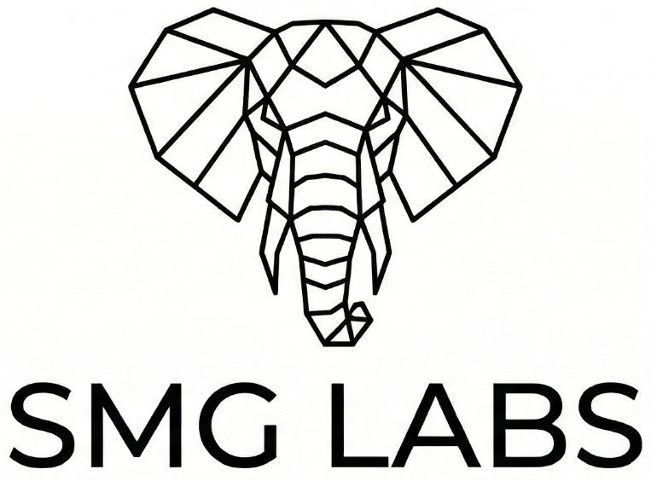
Notes:
Thank you.

